Slide 1
SNS ACADEMY
A fingerprint International School
Affiliated to CBSE New Delhi
Affiliation No :1930610
GRADE XII A (2020-21)
COURSE NAME : BIOLOGY(044)
Chapter-6 MOLECULAR BASIS OF INHERITANCE – INTRODUCTION

Slide 2
Topics to be covered
Structure of DNA
Replication of DNA
Transcription process (making RNA to DNA)
The genetic code
The translation process – protein synthesis
Genomics
Essentials of human genome sequencing or project

Slide 3
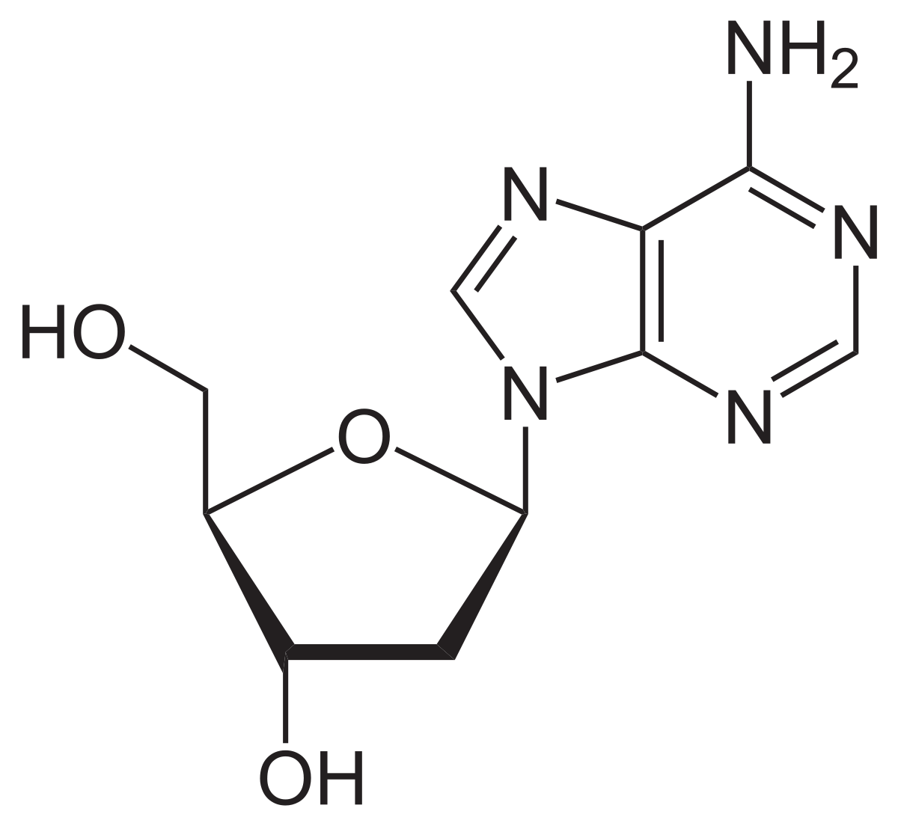
Identify the given structure

Slide 4
Structure of poly nucleotide chain

Slide 5
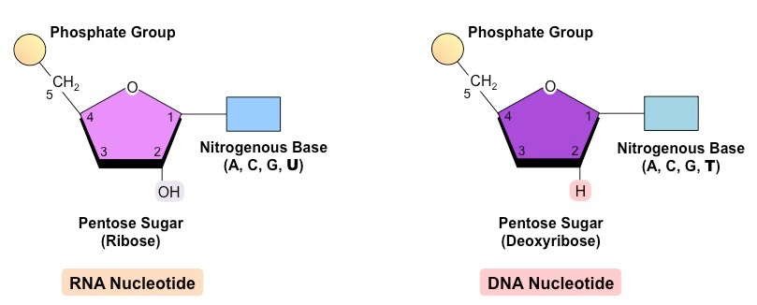

Slide 6
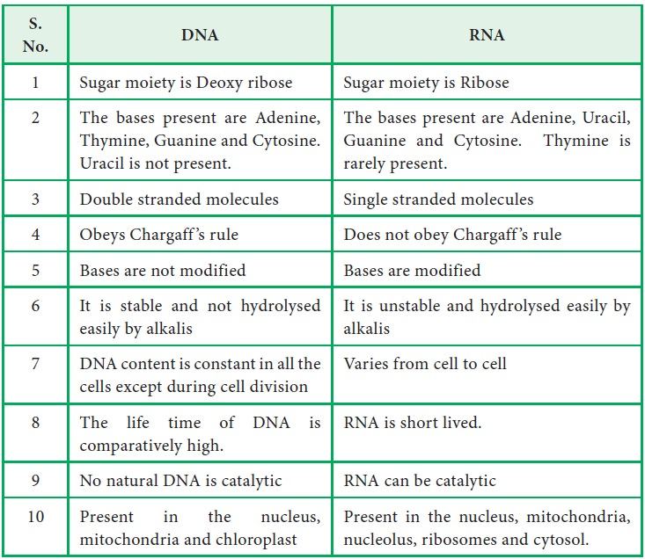

Slide 7
The DNA and RNA
Genetic material
PROERTIES OF GENETIC MATERIALS:
able to replicate itself.
Stable both chemically and structurally.
Provide the scope for slow changes (mutation)- required for evolution.
Express itself in the form of ‘Mendelian characters’.
Have the ability to direct their duplications – rule of base pairing and complementarity.

Slide 8
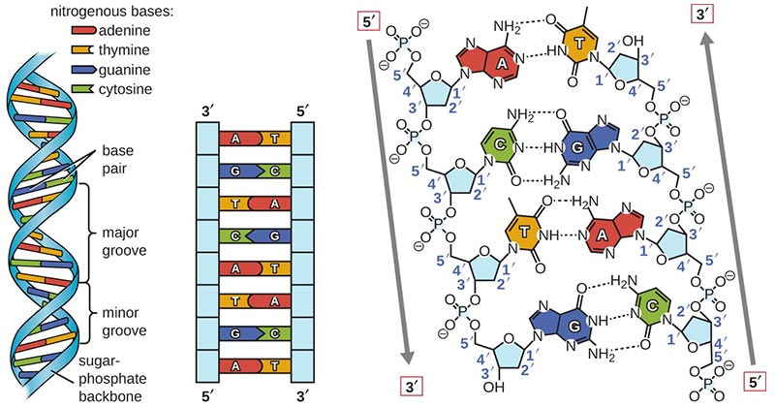

Slide 9
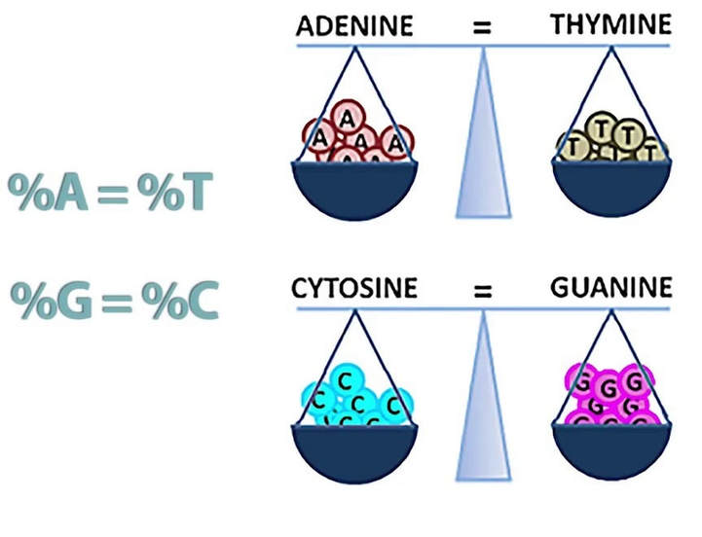
Chargaff's rules.

Slide 10
The Search for Genetic Material
Known
Genes on chromosomes
Chromosomes made of DNA and protein
Unknown
Which chromosomal component was the genetic material
Protein
Heterogeneous class of macromolecules with specific functions
Case stronger initially
Nucleic acids
Physical and chemical properties too uniform for amount of variation
Experimentation gradually changed perceptions
DNA’s role clarified by studying bacteria and their viruses

Slide 12
Cont….
The discovery of nuclein by Miescher and the proportion of principal of inheritance by Mendel were same almost
Material from the nucleus of a cell, considered a single substance when first isolated in the late 1800s but later shown to consist of DNA and associated proteins.
In 1926 – the mechanism of inheritance had reached the molecular level gradually.

Slide 13
THE DNA
Deoxyribonucleic acid (DNA)- genetic material in most organisms.
Long polymer of deoxyribonucleotides.
The no.of nucleotides or base pair in the DNA determines its length.
Length is characteristics of an organisms.
E.coil – 4.6 x 10⁶
Bacteriophage φ 174 – 5,386 bp
Lambda phage – 48,502bp
Human beings - 3.3 x 10⁹ bp (haploid number)

Slide 15
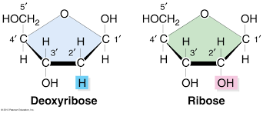
Structure of a poly nucleotide chain (DNA/RNA)
a nucleotide is composed of a nitrogenous base, pentose sugar and a phosphate group.
A PENTOSE SUGAR:

Slide 16
A NITROGENOUS BASE
Nitrogen containing organic molecule – similar physical properties of a base.
i. purines - adenine and guanine
ii. Pyrimidines – cytosine, uracil and thymine
Adenine + ribose sugar adenosine
Adenine + deoxyribose sugar deoxyadenosine
Guanine + ribose sugar guanosine
Guanine + deoxyribose sugar deoxyguanosine
Cytosine + ribose sugar cystidine
Cytosine + deoxyribose sugar deoxycystidine

Slide 19
A PHOSPHATE GROUP
A nucleotide ( or deoxynucleiotide depending upon the type of sugar present) is formed.
Phosphate group is linked to 5’ OH of a nucleoside through a phosphoester linkage.
Two nucleotides when liked through a 3’ to 5’ phophodiester linkage form a dinucleotide.
a. one end with a free phosphate moiety at 5’ end of ribose sugar.
b. the other end with a free hydroxyl 3’ OH group.

Slide 21
Existing Knowledge of DNA
Polymer of nucleotides with 3 components
Pentose sugar (deoxyribose) and a phosphate group
Purines = two rings
Adenine (A)
Guanine (G)
Pyrimidines = one ring
Thymine (T)
Cytosine (C)

Slide 22
Discoveries related to structure and composition of DNA
Friedrich Meischer (1869) – nuclein
Levene (1910) – found DNA contain phosphoric acid and deoxyribose sugar.
Erwin Chargaff (1950) – chargaff rule
James Watson and Francis Crick – double helical structure

Slide 25
Erwin Chargaff
The amount of A, T, G, and C in the DNA vary from species to species
Evidence of molecular diversity to increase DNA credibility
Chargaff’s rules
In each species, the amount of A = T while the amount of C = G
Importance unknown until discovery of double helix
Organism | A | T | C | G
Human | 30.3% | 30.3% | 19.9% | 19.5%
Chicken | 28.8% | 29.2% | 20.5% | 21.5%
Grasshopper | 29.3% | 29.3% | 20.5% | 20.7%
Sea Urchin | 32.8% | 32.1% | 17.7% | 17.3%
Wheat | 27.3% | 27.1% | 22.7% | 22.8%
Yeast | 31.3% | 32.9% | 18.7% | 17.1%
E. coli | 24.7% | 23.6% | 26.0% | 25.7%

